Slide 1
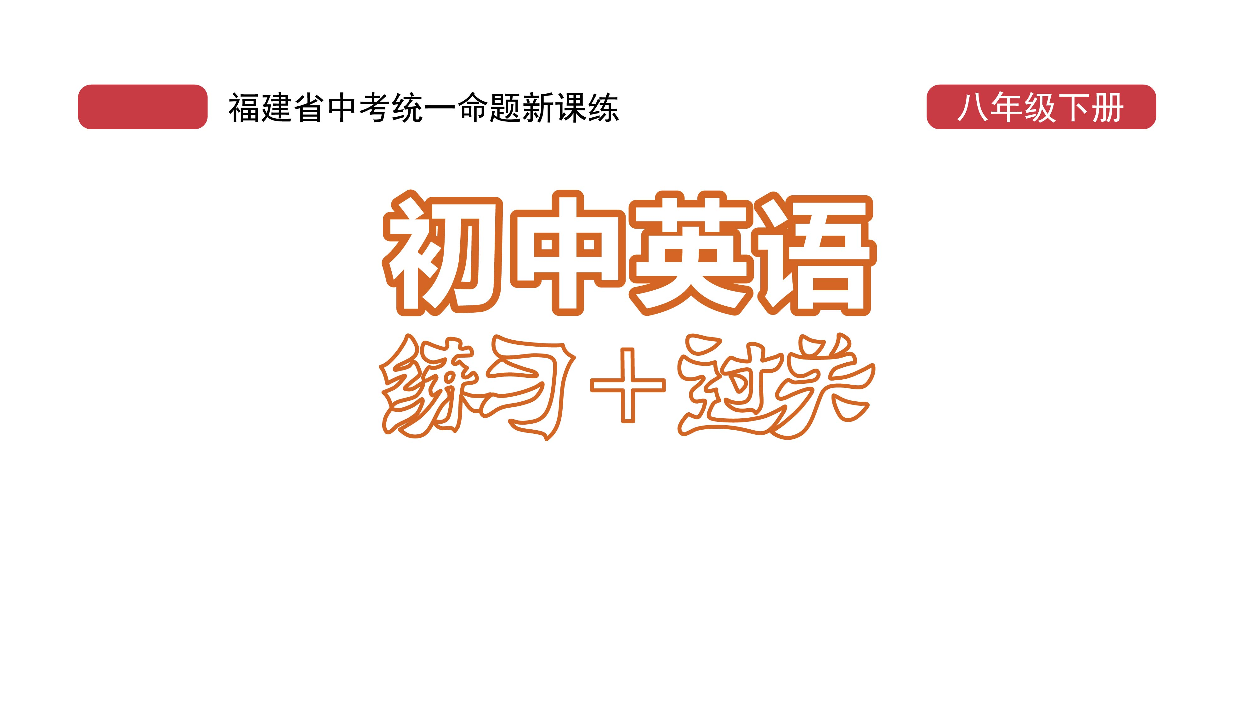
课时练习
模块七 第一章 第四节

Slide 2
一、翻译下列词组。
work for …
the rights of …
make one’s dream come true
a parents’ meeting
1. 为……工________________________________
2. ……的权利 ________________________
3. 使某人的梦想成真 ________________________
4. 一场家长会 ____________________________

Slide 3
二、用括号内所给单词的适当形式填空， 每空不限词数。
1. I regret________(tell) him what I will do.
2. A computer can perform many_______(task) at once.
3. Here are some_________(help) advice to make your journey easier.
4. The book will be useful to the________(parent) of disabled(残疾的) children.
telling
tasks
helpful
parents

Slide 4
二、用括号内所给单词的适当形式填空， 每空不限词数。
5. I didn’t expect him to become a__________(success) writer.
6. The students sold home-made cookies_______(raise) money.
successful
to raise

Slide 5
二、用括号内所给单词的适当形式填空， 每空不限词数。
7.________(fight) against COVID-19, many doctors and nurses worked day and night.
8. The rich man is trying_______(build) a new hospital in the center of the city.
To fight
to build

Slide 6
三、单项选择。
( )1. —What do you know about IoT?
—I know_______it stands for Internet of Things.
A. if B. that C. how
B

Slide 7
三、单项选择。
( )2. —About the Chinese Dream, could you please tell us______, Mr. Wang?
—By pulling together..
A. how can we make it come true
B. how we can make it come true
C. when we can make it come true
B

Slide 8
三、单项选择。
( )3. Faced with all the difficulties, the girl _____her father.
A. turned to B. turned with
C. turned down
A

Slide 9
三、单项选择。
( )4. —I’m not used to using serving chopsticks and spoons(公勺公筷).
—I think you should try to_______. It’s the right thing to do.
A. make a decision B. make a mistake C. make a change
C

Slide 10
三、单项选择。
( )5. —David, which country is the________of the modern Olympic Games?
—Greece.
A. member B. birthday C. birthplace
C

Slide 11
四、将下列句子合并成含有宾语从句的复合句，每空一词。
1. I think … Mobile payment makes our life much easier.
I think (_____) mobile payment______our life much easier.
2. I think … You aren’t telling me the truth(真相).
I_____think (_____) you_____telling me the truth.
that
makes
don't
that
are

Slide 12
四、将下列句子合并成含有宾语从句的复合句，每空一词。
3. I hope … You will be better soon.
I hope (_______) you_______be better soon.
4. Do you know …? A day on Venus(金星) lasts longer way than a day on Earth.
Do you know (______) a day on Venus(金星)______ way longer than a day on Earth.
that
will
that
lasts

Slide 13
四、将下列句子合并成含有宾语从句的复合句，每空一词。
5. I heard … He joined the army last year.
I heard (_______) he__________the army last year.
that
joined

Slide 14


